Slide 1
Uncertainty in building performance simulation
Workshop at CEPT University, Ahmedabad, India
Parag Rastogi
05-06 January, 2019

Slide 2
Workshop agenda
Background and motivation: why should I care?
What is uncertainty and sensitivity?
How do we interrogate a building design or model?
This workshop: why regression models?
Data-based methods – advantages and disadvantages
Team projects: uncertainty and sensitivity

Slide 3
background and motivation
why you should care

Slide 4
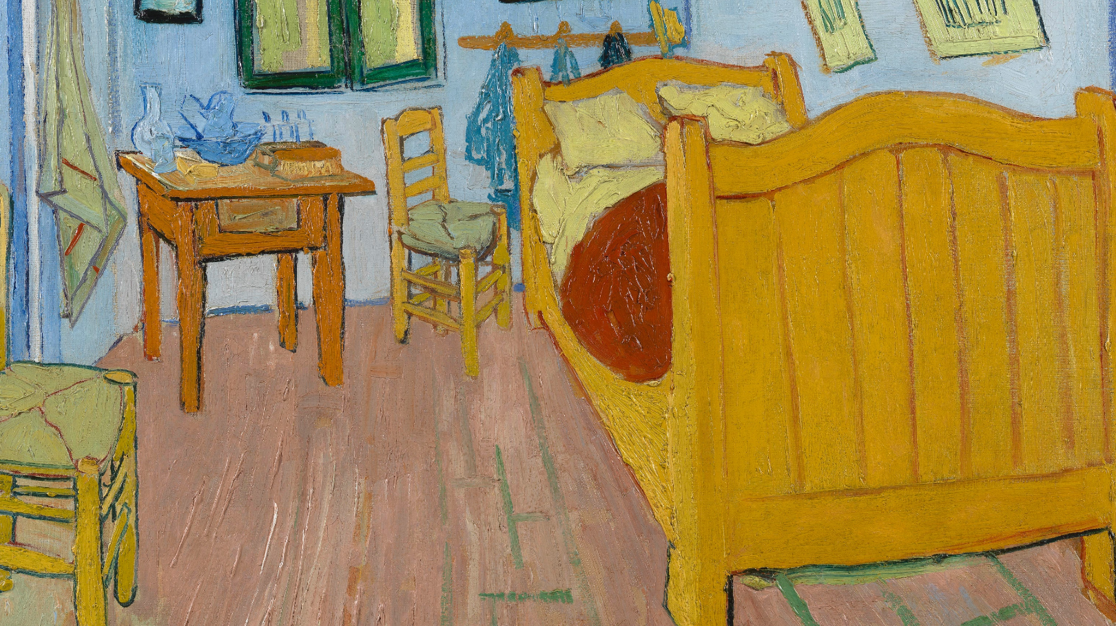
buildings, humans, and climate
The Bedroom,
Vincent van Gogh,
1888.
Notes:
I’ll begin by introducing the subproblem I will be addressing in my talk.

Slide 5

60,000 years-ish of this…
Tiger in a Tropical Storm (Surprised!), Henri Rousseau, 1891

Slide 6
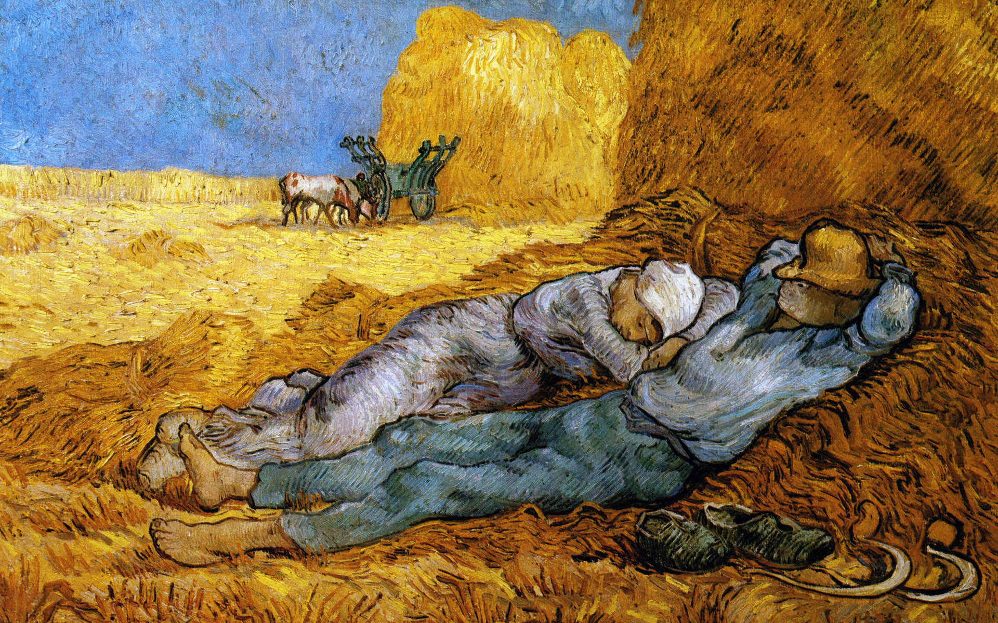
12,000 years-ish of this…
Siesta, Vincent van Gogh, 1890

Slide 7
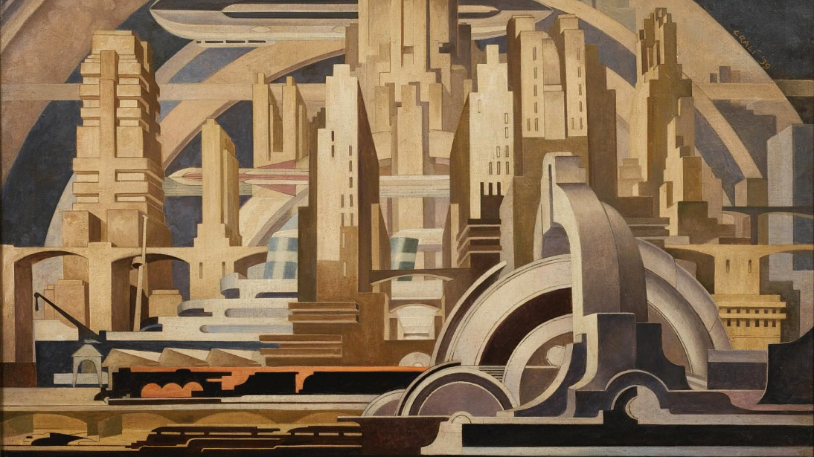
200 years-ish of this…
Cityscape, Tullio Crali, 1939

Slide 8
buildings
Increasingly integrated into the grid:
contribute both demand and supply

Slide 9
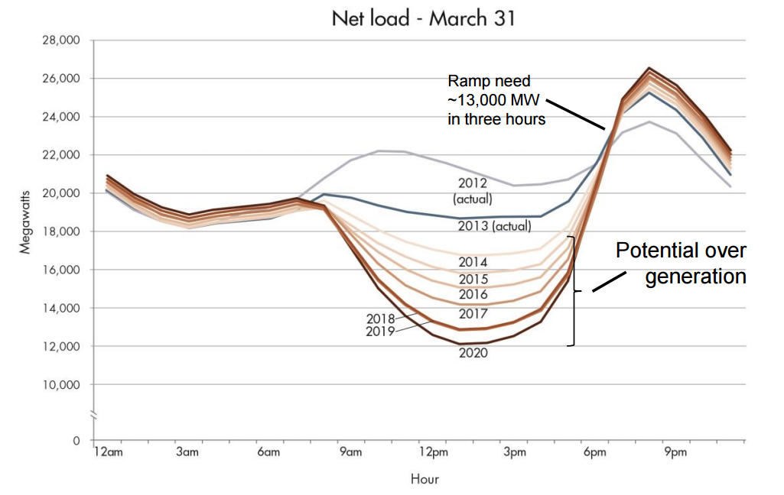

Slide 10
buildings
Increasingly integrated into the grid:
contribute both demand and supply
Built today → operated tomorrow

Slide 11


planning and operation
Robust,
uncertainty-aware
planning
Human-centric,
data-driven
operation

Slide 12
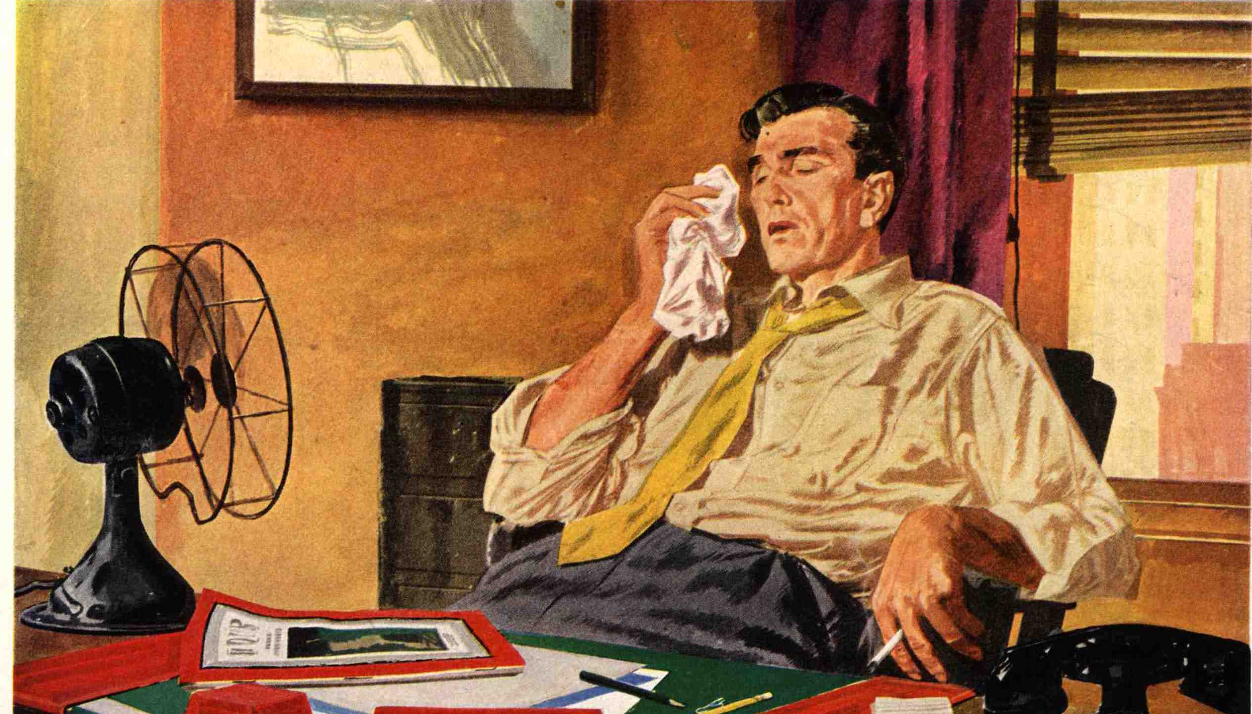
comfortable → overheating
Carrier Corporation

Slide 13
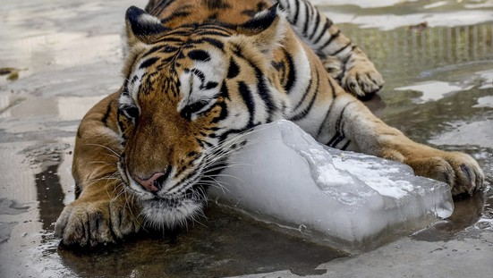
unprecedented peak cooling loads
SHAHZAIB AKBER/EUROPEAN PRESSPHOTO AGENCY

Slide 14
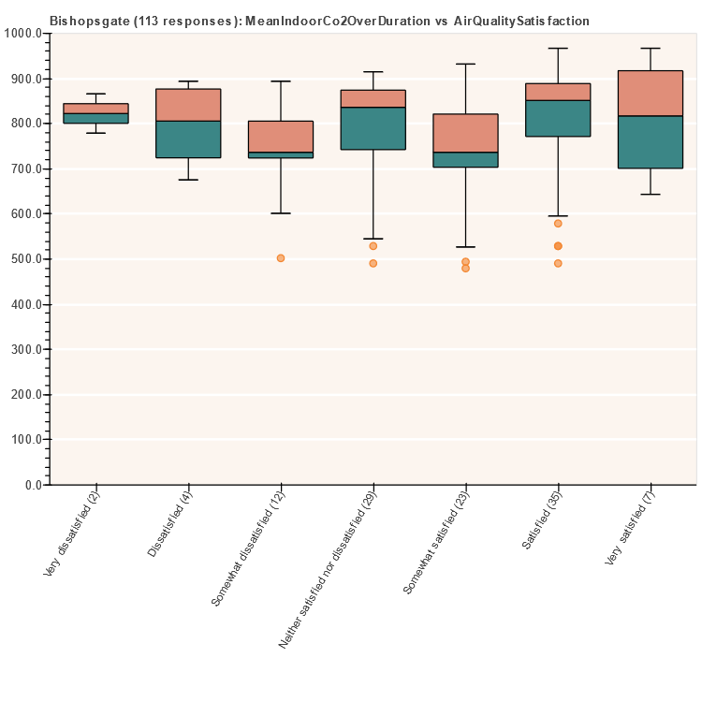
satisfaction vs measurements
Good mechanical ventilation but responses still vary widely

Slide 15
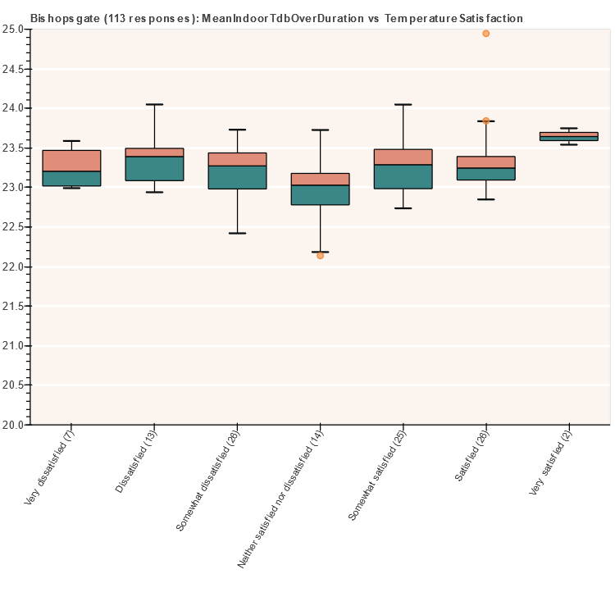
satisfaction vs measurements
Similar average temperatures yet diversity of responses

Slide 16
Uncertainty
you don’t know things
There are more things in heaven and earth, Horatio, Than are dreamt of in your philosophy. [Hamlet]

Slide 17
Why you should care
All Models are wrong¹
Approximately right > precise but wrong²
Uncertainty analysis and error bars are good, but…
No excuse for sloppy modelling & design
1. McCullagh and Nelder (1983), Generalized Linear Models
2. Paraphrased from The Black Swan: The Impact of the Highly Improbable (Nassim Nicholas Taleb)

Slide 18
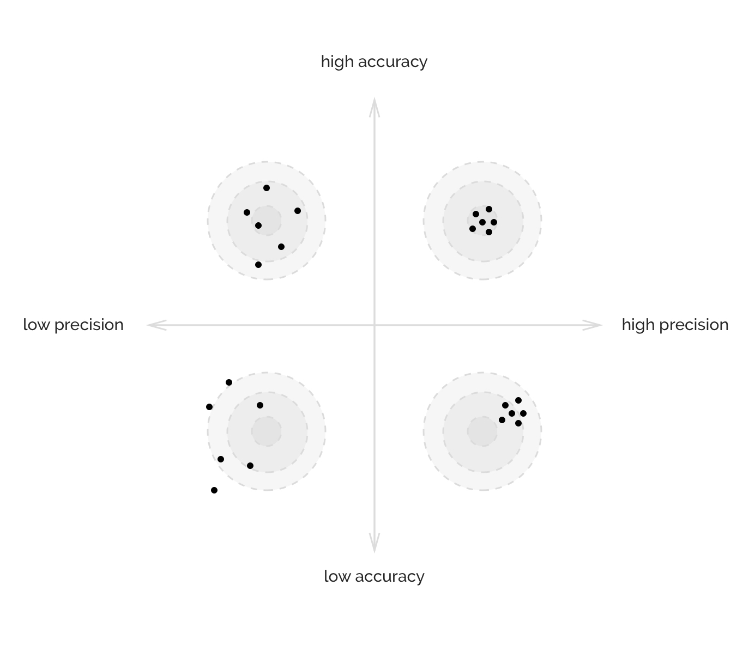
Notes:
What you see here is that if you were to use a typical file.

Slide 19



Coverage
several possible pathways of future climate
simulation requires high temporal resolution
(hourly or better)
large number of simulations required for good coverage of possible futures

Slide 20






Estimating future conditions
vs
Single ‘typical’ file
Many files

Slide 21
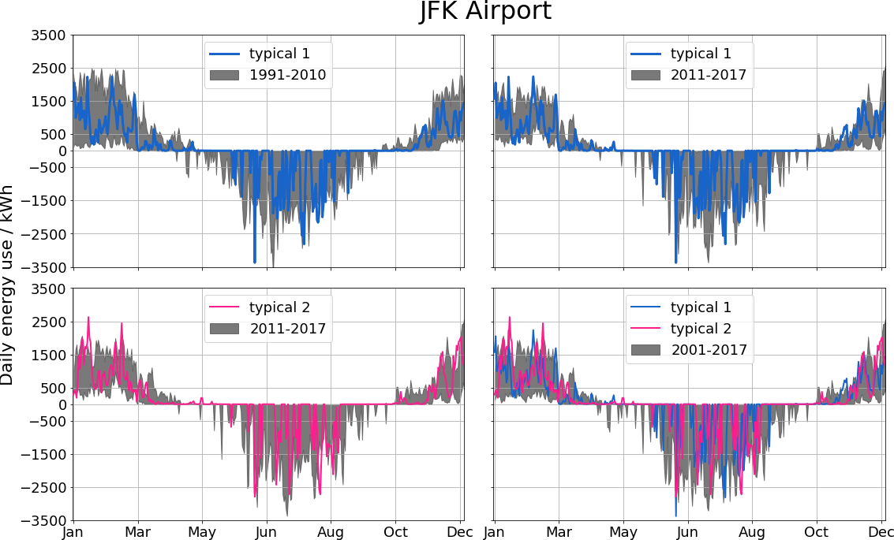
STATION
DAILY SUM
HEATING
COOLING

Slide 22
STATION
DAILY SUM
WEATHER SOURCE
ACTUAL YEAR
HEATING
COOLING

Slide 23
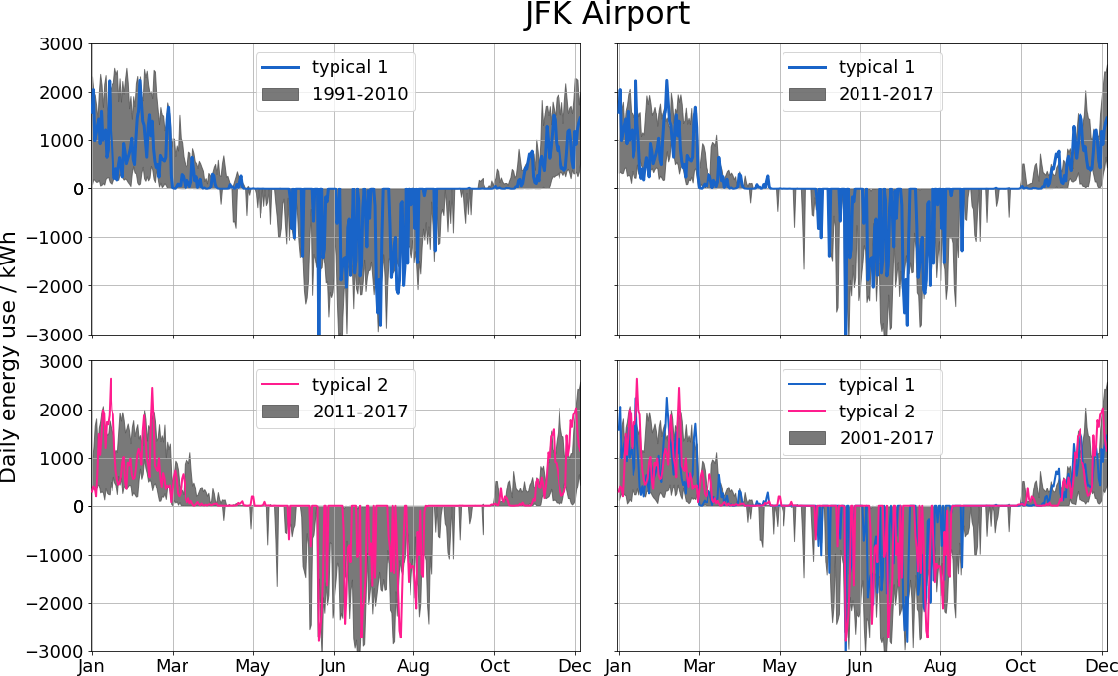
Notes:
A single ‘typical’ file leads to (1) Patchy coverage, and (2) No estimate of extremes.

Slide 24
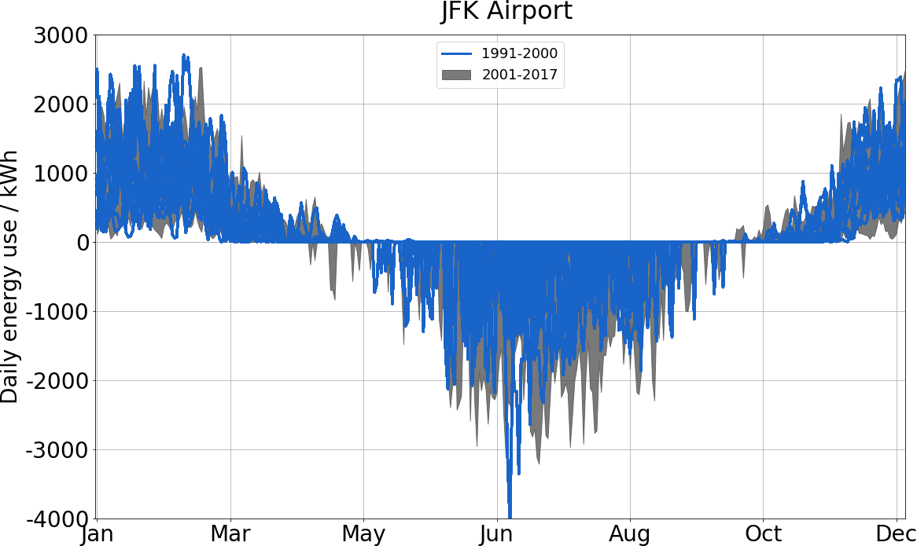
Notes:
Historical data from one decade, used to plan for the next 17 years.

Slide 25
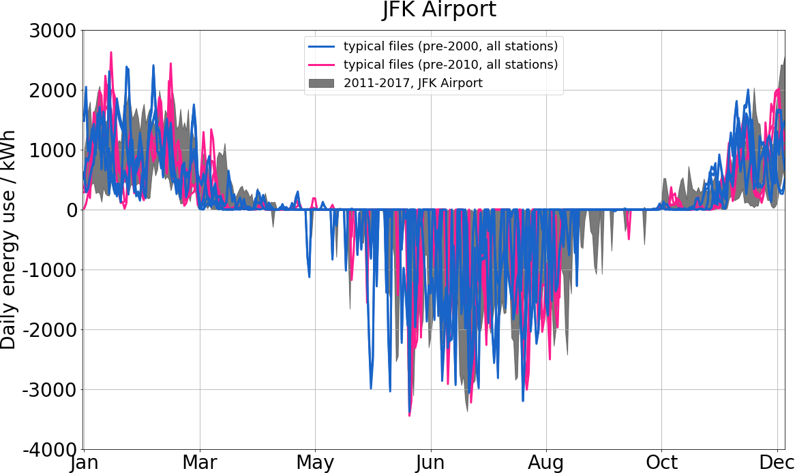
Notes:
Many typical files from nearby stations gives a similar result (9 in total).

Slide 26
Summary
Future not exactly predictable, so
Average over many scenarios
Picking a scenario is difficult
Using many realistic scenarios gives a more informative result

Slide 27
Types of uncertainty
Epistemic
When you don’t know something, like a material property
Can be reduced with better information
e.g., window properties, wall construction.
Aleatory
When things really are random, or random to the best of our knowledge
Cannot usually be reduced with better information
e.g., people’s behavior, weather, etc.

Slide 28
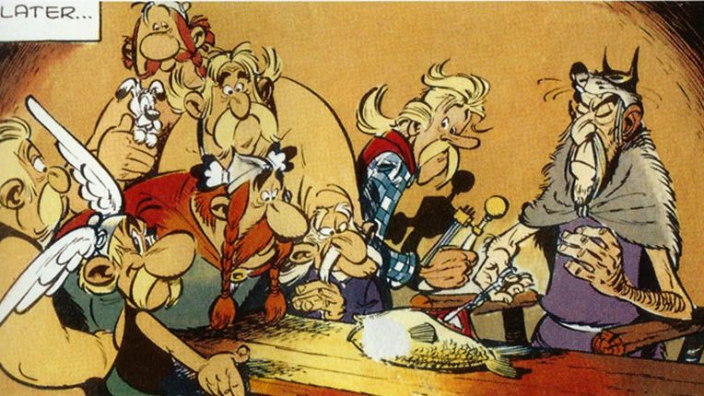
What do you mean the future is not exactly predictable?
Asterix and the Soothsayer,
Uderzo,
1972

Slide 29
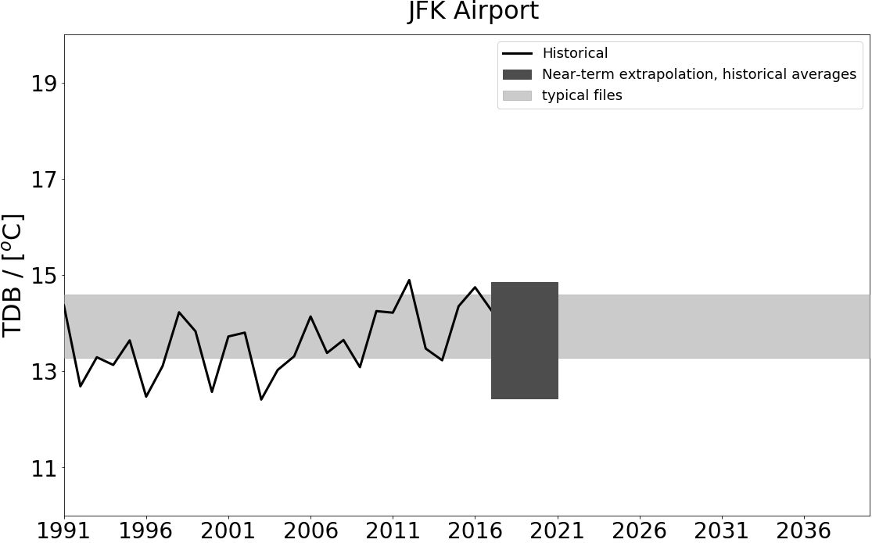
Notes:
What you see here is that if you were to use a typical file.

Slide 30
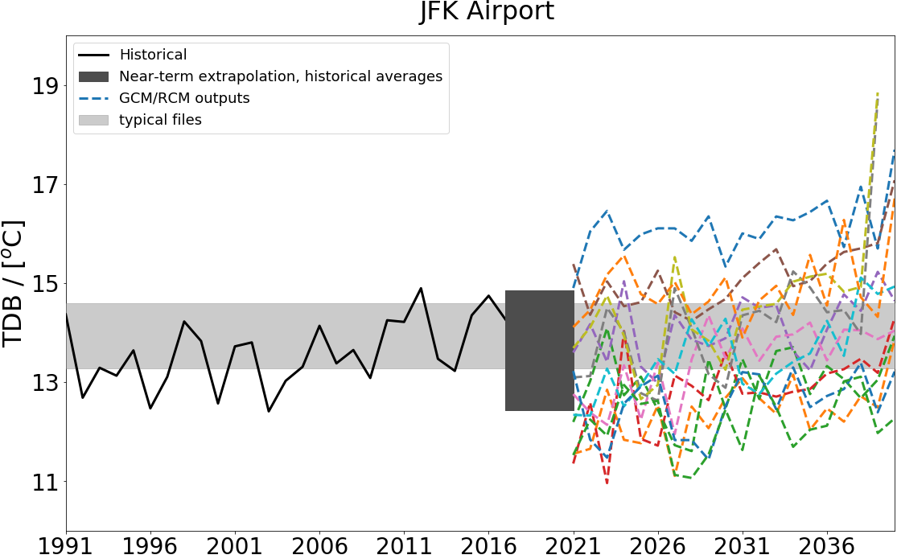
Notes:
What you see here is that if you were to use a typical file.

Slide 31

simulation to the rescue!

Slide 32
Sensitivity
how some things affect other things

Slide 33
Correlates changes in inputs to changes in outputs
Influence of each input is usually not obvious
Effect of different inputs is correlated
We will mostly explore sensitivity through group projects

Slide 34
Data-based approaches
black-box models

Slide 35
Data-based approaches
Pros
Cons
Data from the real world is better than simulations
Models are often very fast
Can be improved with more data
Data may be not be representative of problem
Collecting data is slow
Often only applicable to the problem at hand – difficult to generalise

Slide 36
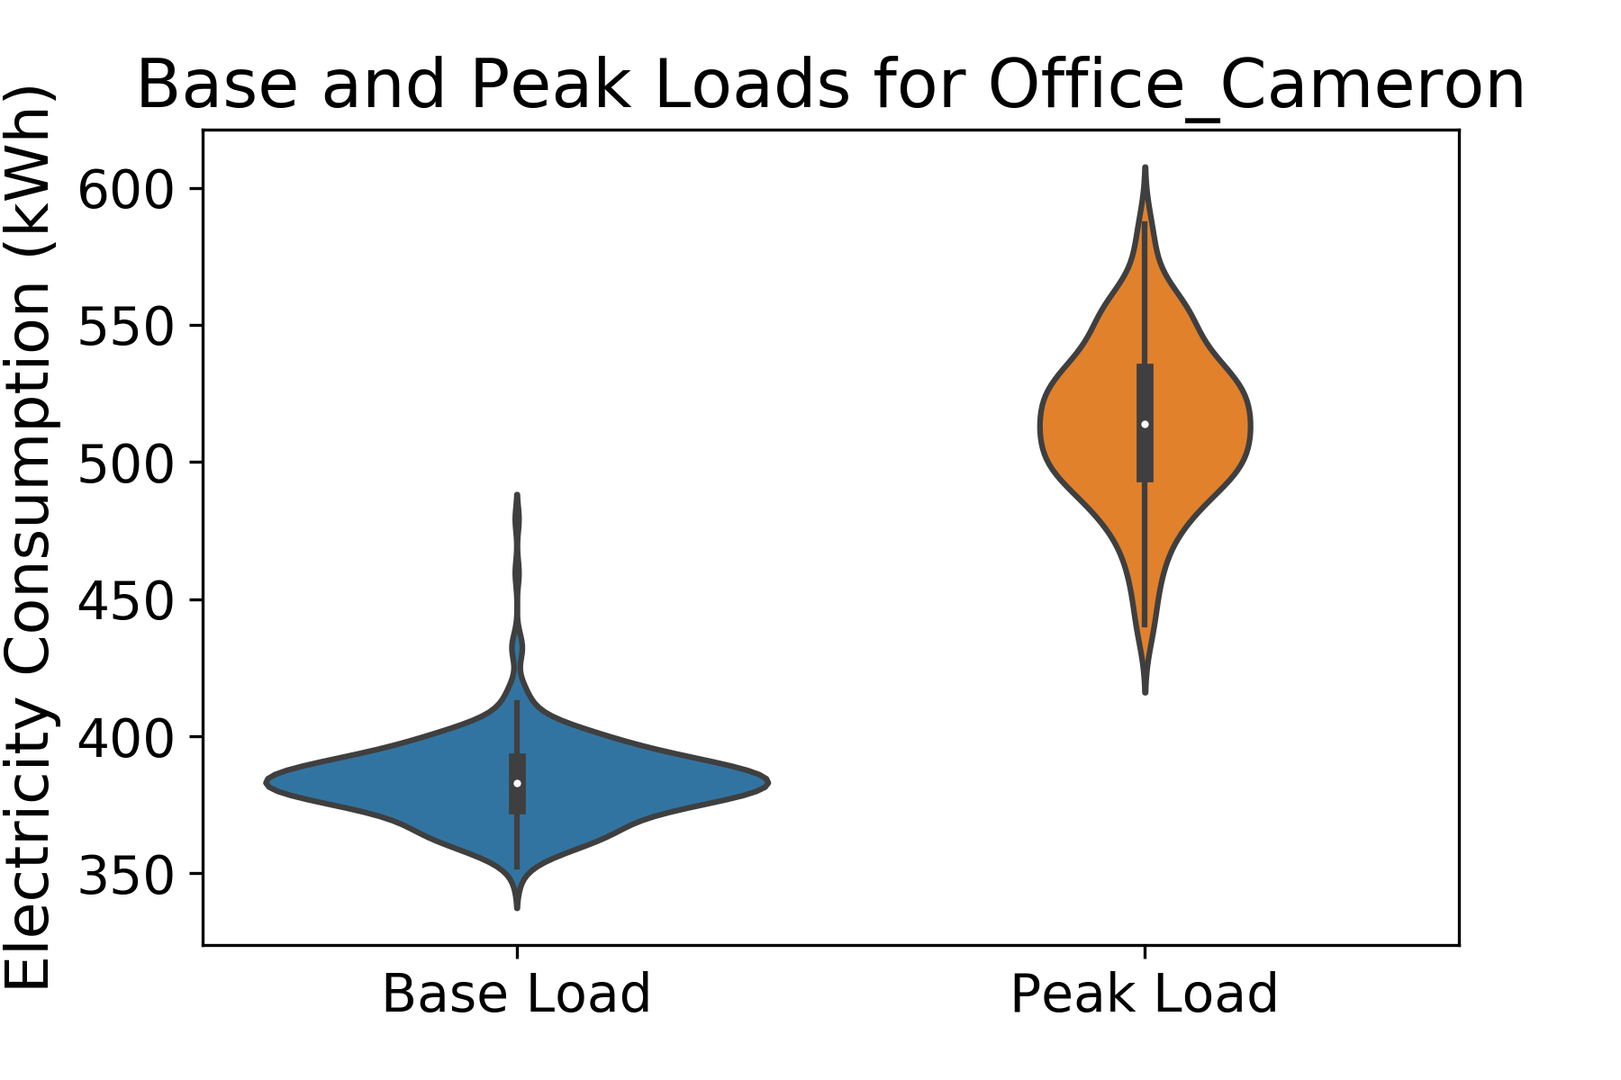

Slide 37
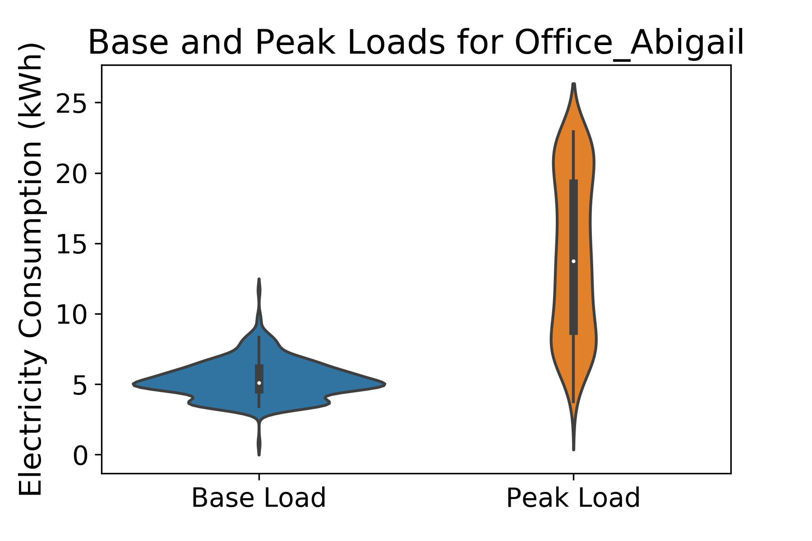

Slide 38
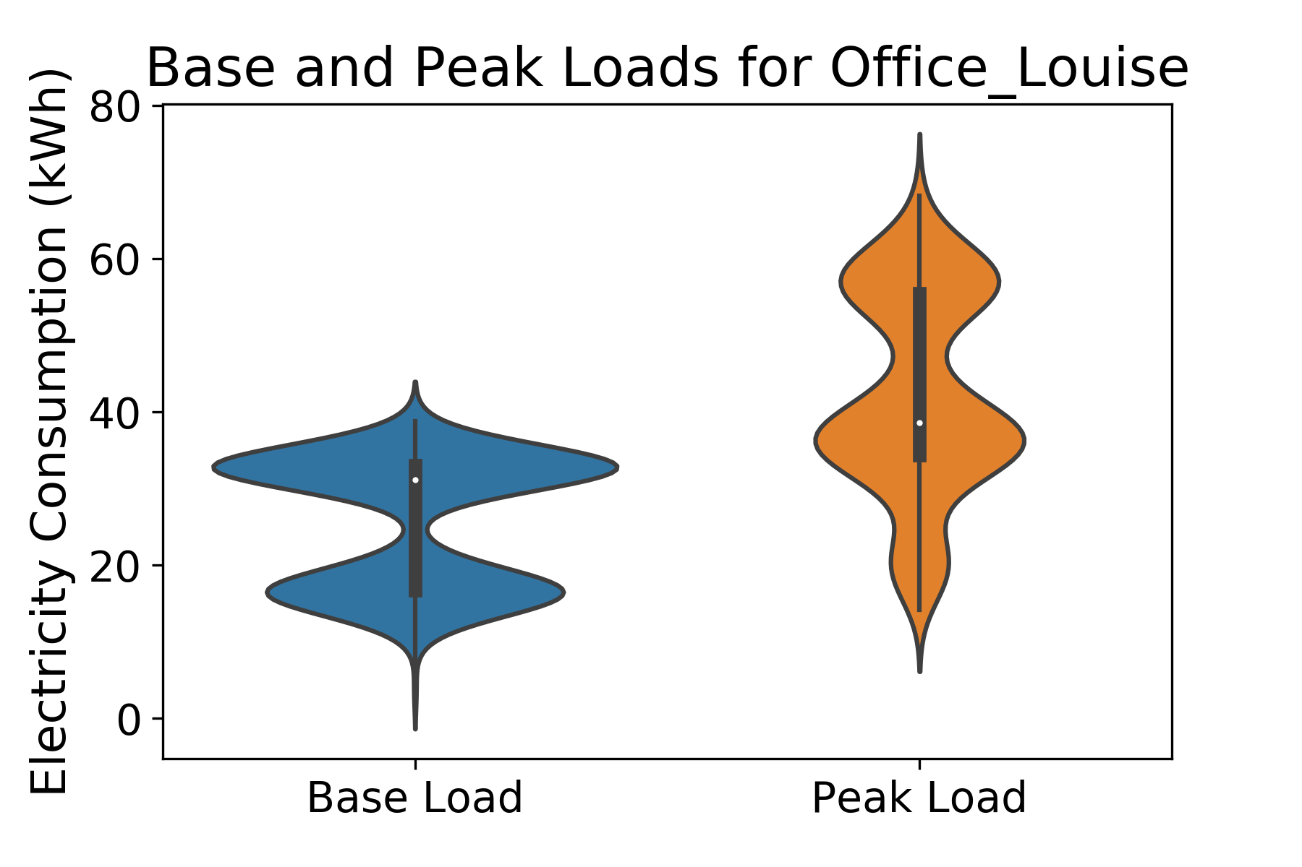

Slide 39


Slide 40
